Slide 1
Comparing the interaction of dry air incursion with monsoon depression using ERA-5 and IMDAA reanalysis datasets
Seventh WMO International Workshop on Monsoon (IWM-7)
22-26 March, 2022, IMD, MoES, New Delhi, India
Abstract ID: 45
Gokul Vishwanathan¹, Raghavendra Ashrit², Kieran M. R. Hunt³, Jennifer K. Fletcher⁴, Ashis K Mitra²
¹ School of Physical and Chemical Sciences, University of Canterbury, New Zealand
² National Centre for Medium Range Weather Forecasting, Noida, India
³ Department of Meteorology, University of Reading, Reading, UK
⁴ School of Earth and Environment, University of Leeds, Leeds, UK
Email : gokul.vishwanathan@pg.canterbury.ac.nz

Slide 2
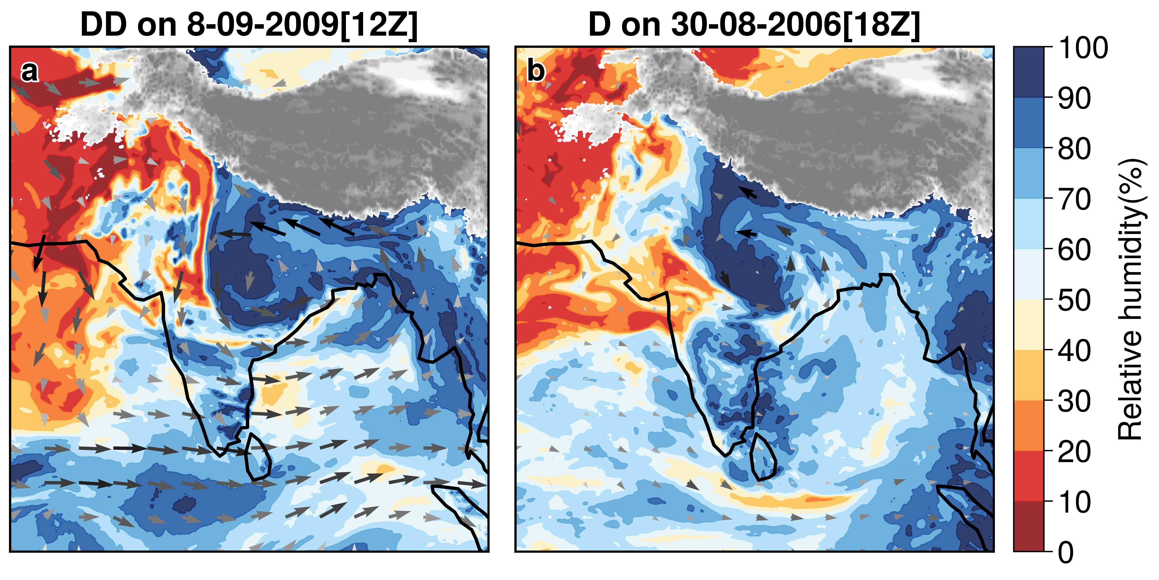
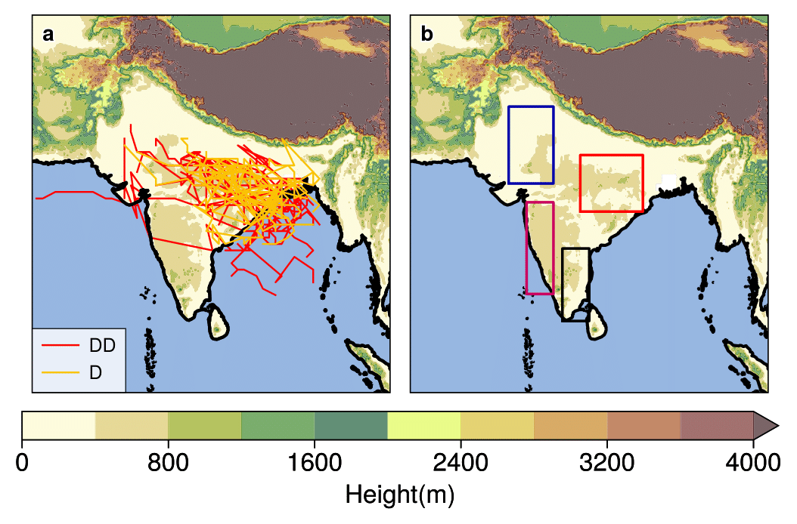
Objective and methodology
Key Objectives
Monsoon depression (MD) and its interaction with dry air incursion (DI at 700–400 hPa).
Dry air incursion
Data and Method
Datasets – IMDAA , ERA-5 and IMD gridded rainfall product (1982 - 2012 )
Dataset and Method - 42 (D events) and 35 (DD events) over BOB with dry air incursion data based on Fletcher et.al (2018)
R2
R1
R3
R4

Slide 3
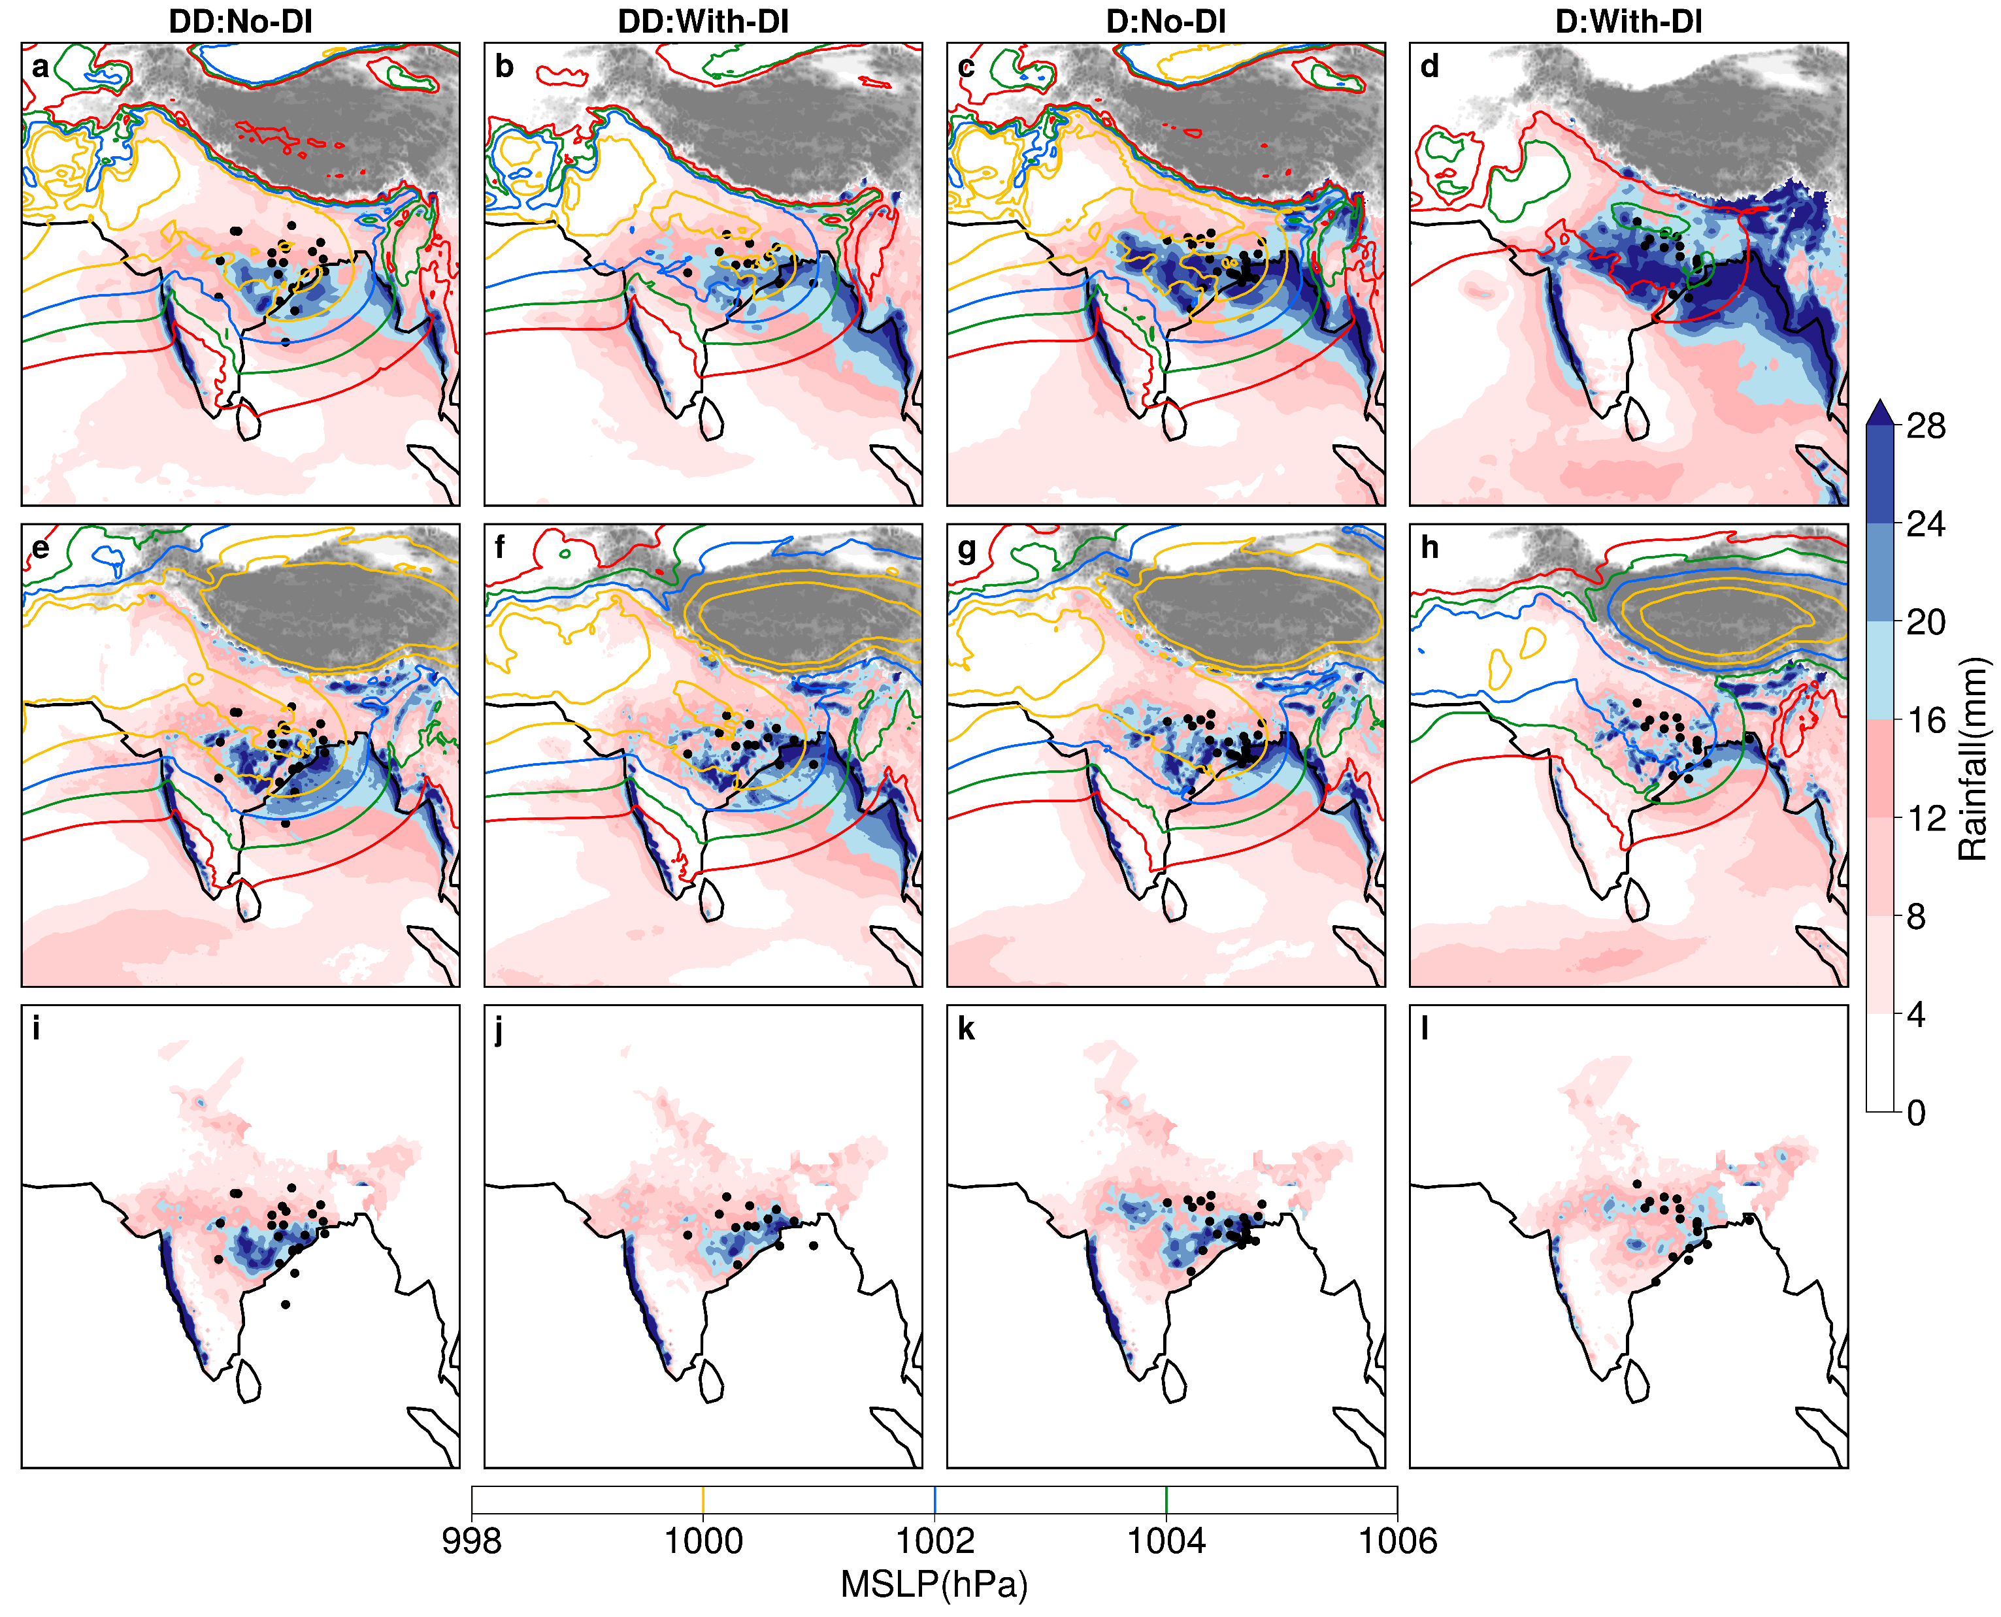
Key Results and Summary
R2
R1
R3
R4
1. Spatial and regional distribution of accumulated precipitation
DD-No-Di
DD-With-Di
D-No-Di
D-With-Di
Realistic representation of monsoon features in IMDAA, ERA5 exaggerates
Wet bias in ERA5 for D with DI
75% drop in low-level convergence over R3 for D-With-DI
IMDAA picks up the fine scale structure embedded within the cyclonic systems which ERA5 could not.
ERA-5
IMDAA
IMD
2. OLR and divergence (975, 500 and 300 hPa) pattern
No dry air incursion
With dry air incursion

